Slide 1
MASON
MASON is an open-source, multiagent, multi-domain, discrete-event simulation toolkit written in Java. It was designed to facilitate large-scale simulations and it provides tools for visualization in 2D and even in 3D.
More information can be found at MASON is available at:
S. Luke, C. Cioffi-Revilla, L. Panait, and K. Sullivan, “Mason: A new multi-agent simulation toolkit,” in Proceedings of the 2004 SwarmFest Workshop, vol. 8, 2004. [Online].
Available: http://cobweb.cs.uga.edu/~maria/pads/papers/mason-SwarmFest04.pdf

Slide 2
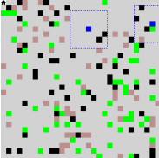
Tileworld system based on MASON
Tiles are green, holes are purplish, obstacles are black, and agents are blue. Dashed lines around agents signify the range of their sensors.

Slide 3
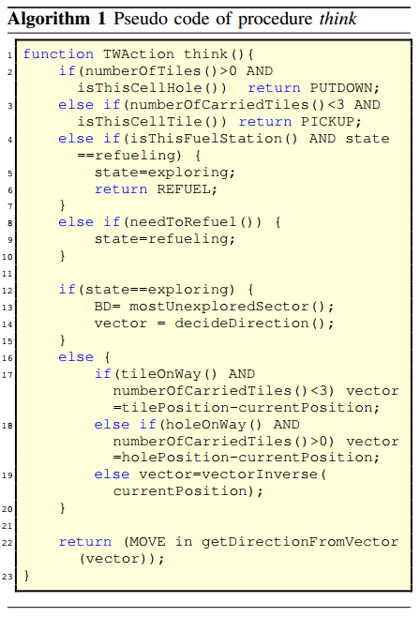
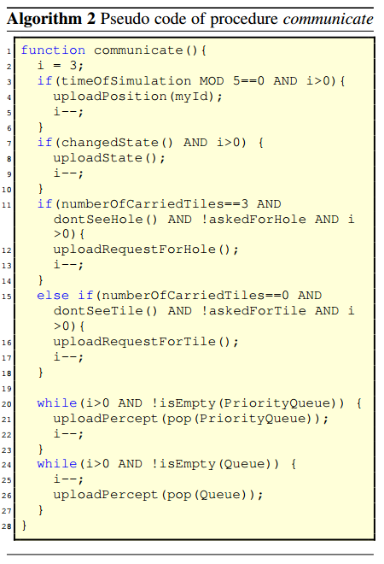
Algorithms

Slide 4
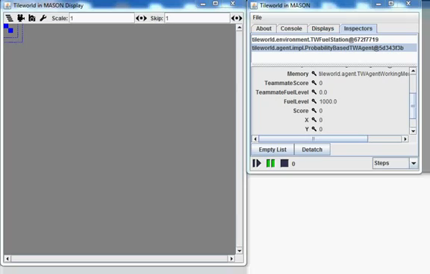
Demo

